Slide 1

PLAY NOW

Slide 2
Back to Game
Restart Game
Save Game
Exit Game

Slide 3
3
4
5
1

Slide 4
Back to Main Menu

Slide 5

1
2
3
4
5

Slide 6
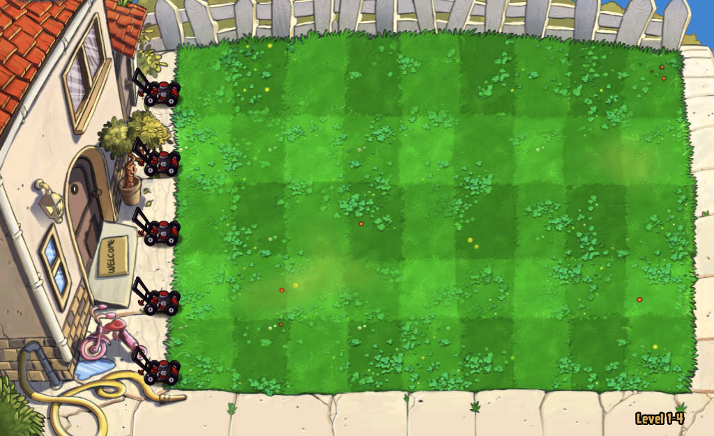
Made by – Himanshu and Udit

Slide 8
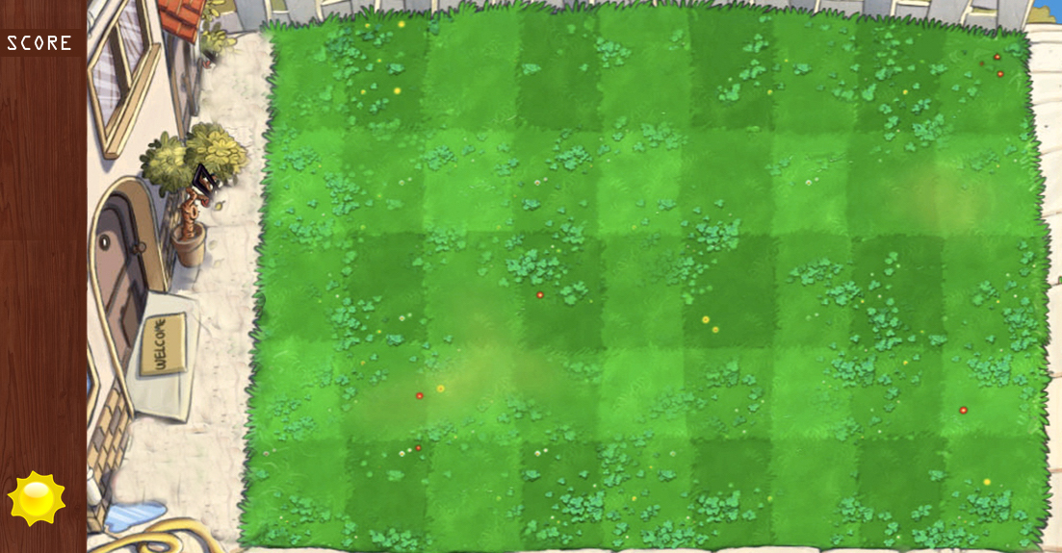

Slide 9
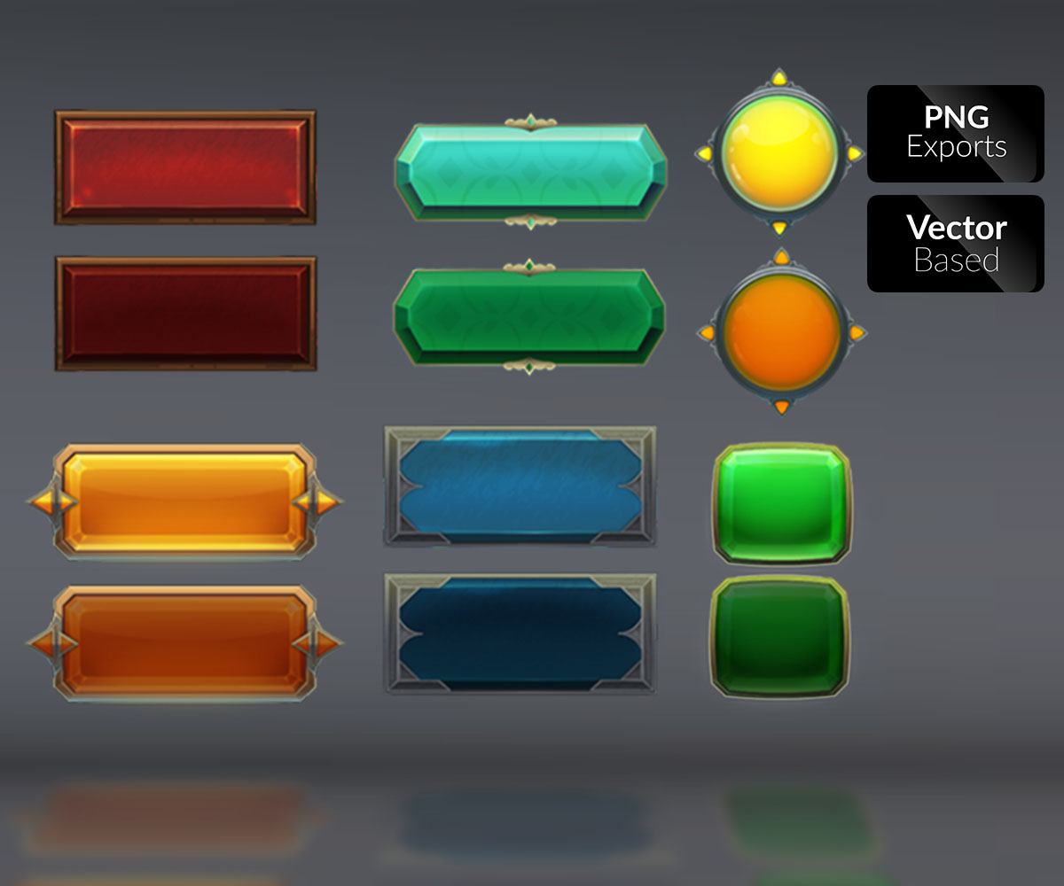
SAVE
RESTART
LOAD GAME
NEW GAME
EXIT

Slide 10
CHOOSE LEVEL

